Slide 1
PRESENTATION ON INSURANCE ANALYTICS
Prepared By
Mandeep Singh
Ratnam Veera
Bandi Sukeerthi
Rakshan M
Chandrika

Slide 2
SUMMARY
It provides key insights into the performance of insurance-related activities, particularly in cross-sell, renewals, and new policies. It highlights performance metrics for account executives and tracks revenue opportunities.
The insurance branch has strong performance in renewals, exceeding its target significantly. However, new business generation is struggling and needs improvement. Cross-sell performance is moderate, with room to increase invoiced achievement. Account executives like Gilbert and Abhinav are leading in performance, indicating strong engagement efforts.

Slide 3
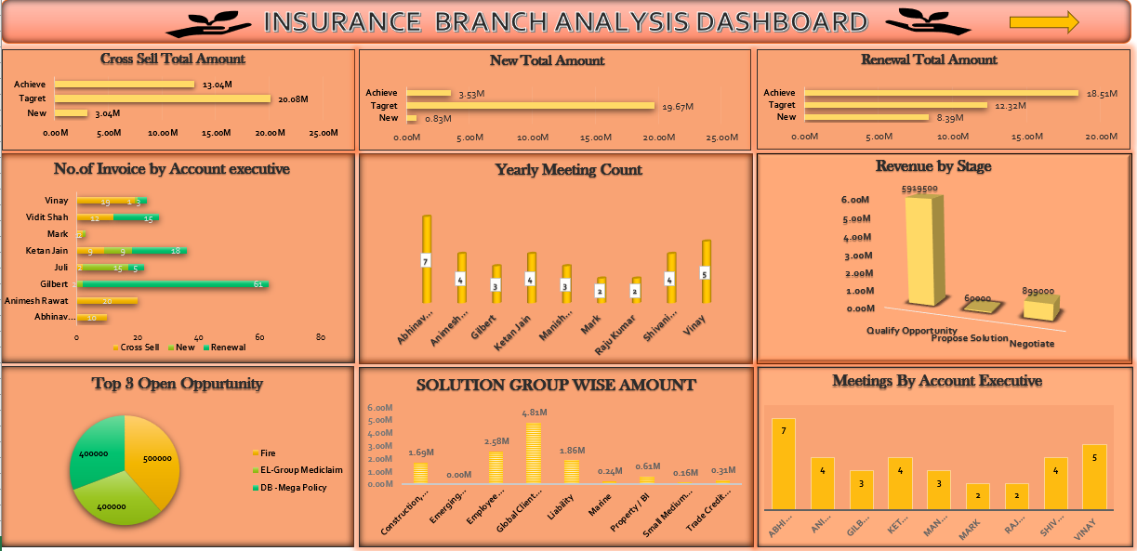
Excel Dashboard

Slide 4
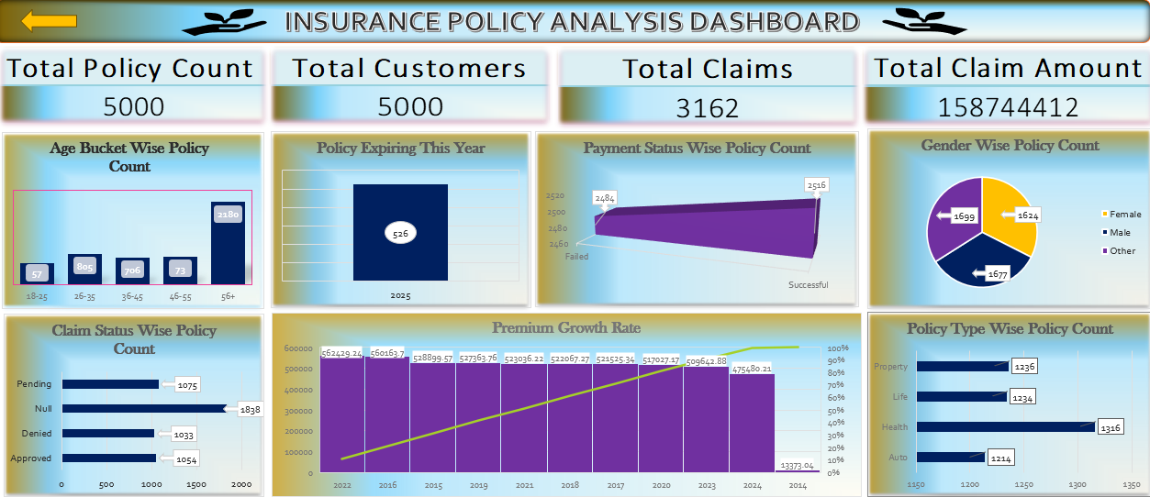
Excel Dashboard

Slide 5
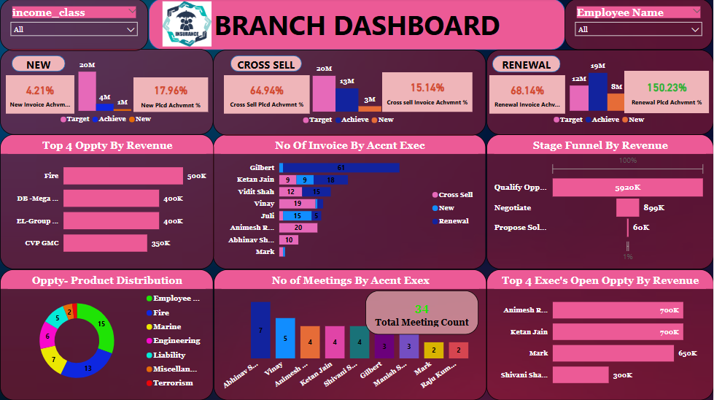
Power Bi Branch Dashboard

Slide 6
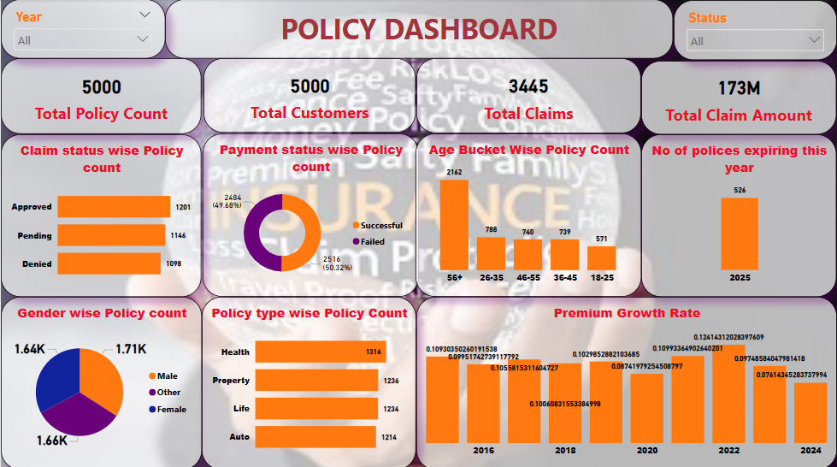
Power bi Policy Dashboard

Slide 7
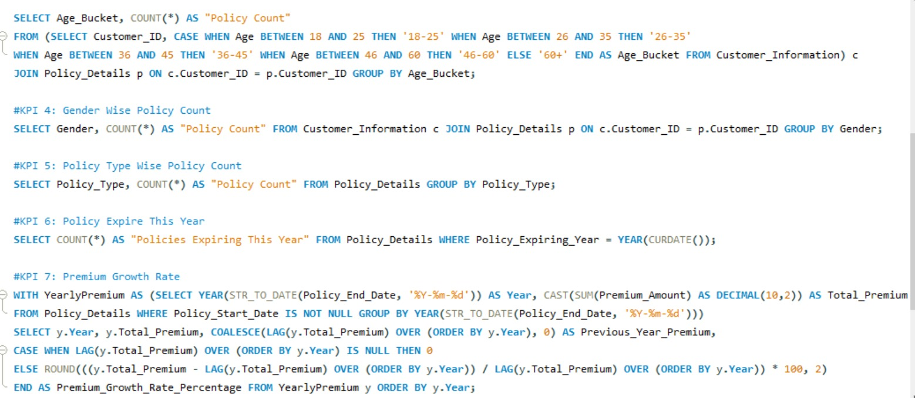
SQL QUERIES

Slide 8
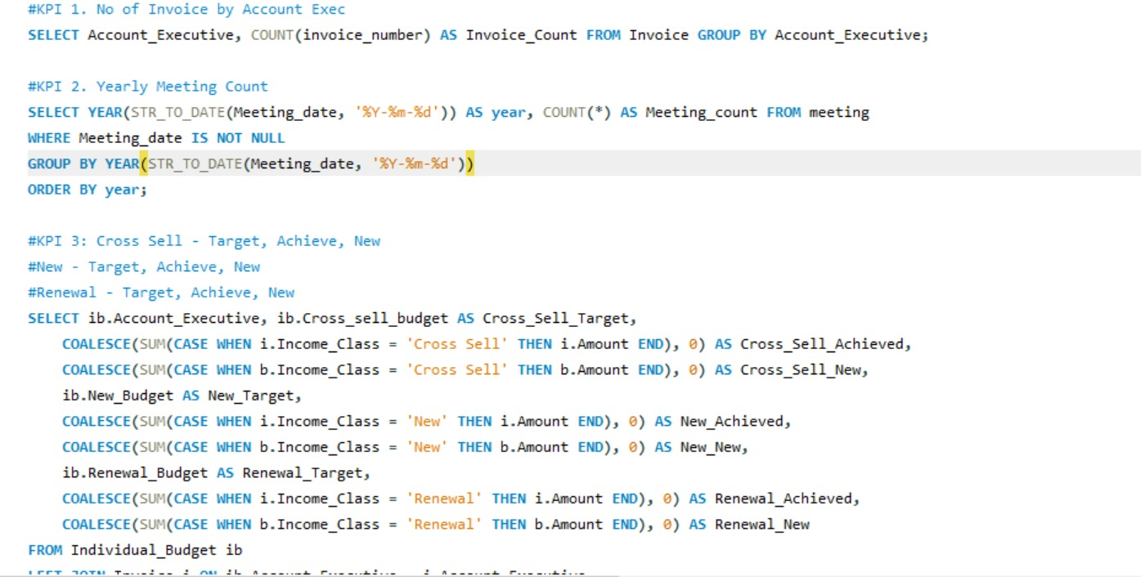
SQL QUERIES

Slide 9
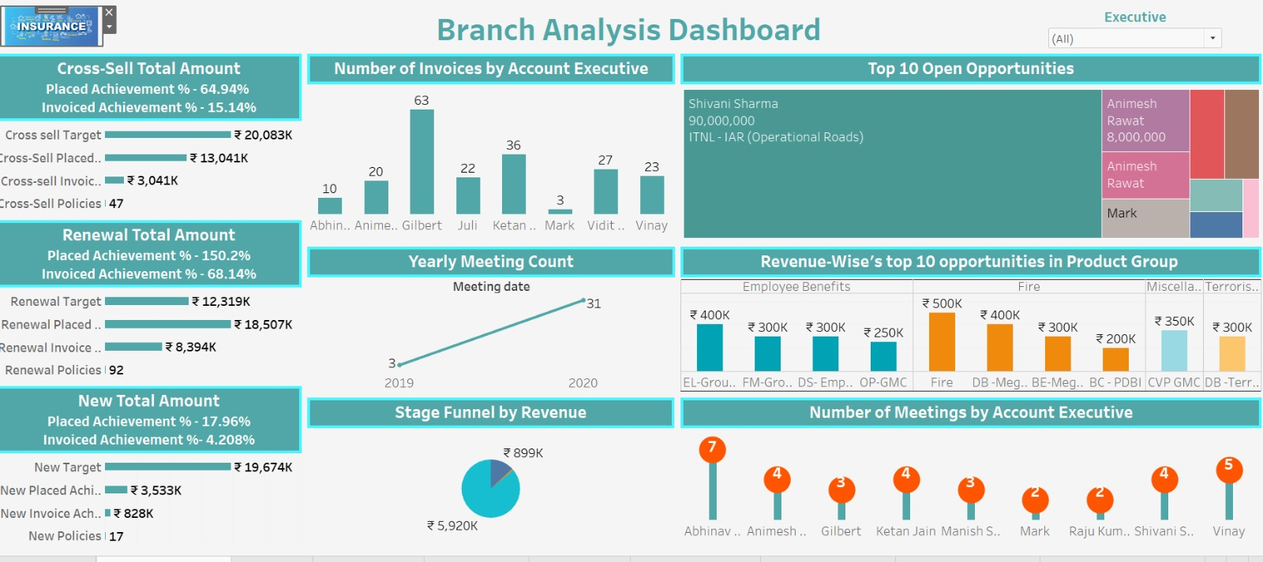
Tableau Branch Analysis Dashboard

Slide 10
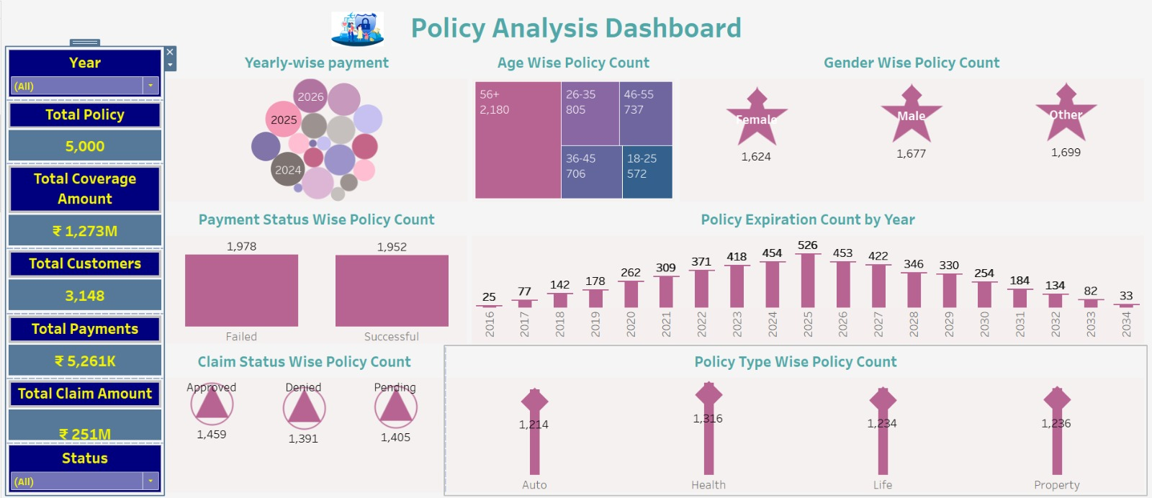
Tableau Policy Analysis Dashboard

Slide 11
Key Recommendations to improve sales
1. Enhance Cross-Selling Efforts
✅ Increase Customer Awareness – Provide targeted promotions and personalized insurance bundles to existing customers. ✅ Train Account Executives – Improve their cross-sell strategies through workshops and performance-based incentives. ✅ Improve Invoicing Process – Since invoiced achievement is low (15.14%), streamline documentation and payment follow-ups.
2. Strengthen New Business Acquisition
🚀 Lead Generation Strategies – Invest in digital marketing, referrals, and corporate partnerships. 🚀 Executive Engagement – Since new policy achievement is just 17.96 %, account executives must focus more on first-time customers. 🚀 Reduce Bottlenecks – Identify approval delays and optimize underwriting for faster policy issuance.

Slide 12
3. Maintain Renewal Excellence & Boost Revenue
📈 Leverage Data Analytics – Identify patterns of renewal behavior and engage clients before expiration. 📈 Loyalty Discounts & Upselling – Offer premium benefits or discounts to encourage renewals. 📈 Fast-Track Renewals – Simplify the process to maintain the strong 150.2% placed achievement
4. Improve Account Executive Performance
👨‍💼 Expand Training for Low-Performing Executives – Encourage knowledge sharing from top performers like Gilbert. 👨‍💼 Optimize Meeting Strategies – Since some executives have fewer meetings, they should engage more prospects actively. 👨‍💼 Incentivize High Performers – Reward Gilbert and other top executives to maintain motivation.

Slide 13
Thank you

